Slide 1
TRUE COLORS
Elon Kline, Delaware ‘20
Chapter Development Coordinator
Professional Optimist, Self-Development Junkie, Color Blind

Slide 2
Why is your leadership style important?
Your leadership style affects…
Lead
Others
Receive
From Others
Perceive
Yourself
How you lead others towards a common vision or goal
How you receive leadership from others as a follower
The first step of developing your leadership. Which is perceiving your characteristics, feelings, and motives

Slide 3
Team Formation (Tuckman Model)
By Bruce Tuckman, 1965
Storming
Performing
Forming
Norming
Adjourning
Notes:
Pick one. The Avengers clip only labels the first four phases, so if you choose that, point out that the Adjourning phase begins at the 6:14 time-mark.
https://www.youtube.com/watch?v=annN-6JVBIo – Avengers: Age of Ultron (7:48)
https://www.youtube.com/watch?v=ysWWGf8VsOg – The Lord of The Rings: The Fellowship of the Ring (4:59)

Slide 4
4 Phases
Forming
Storming
People acquaint themselves with one another; ground rules are established
True feelings bubble up; individual interests take precedence over the team
Norming
Performing
People feel like a valuable part of the team; diversity is embraced; clear expectations
Clear vision and purpose; high efficiency, flexibility and trust; tasks are delegated

Slide 5
4 Phases
Forming
Storming
People acquaint themselves with one another; ground rules are established
True feelings bubble up; individual interests take precedence over the team
When have you seen your phase happen during staff or in your chapter?
How can you support your team members during this phase?
Norming
Performing
People feel like a valuable part of the team; diversity is embraced; clear expectations
Clear vision and purpose; high efficiency, flexibility and trust; tasks are delegated

Slide 6
Lead
Others
Receive
From Others
Perceive
Yourself
Receive leadership from others as a follower
The first step of developing your leadership. Which is perceiving your characteristics, feelings, and motives
Lead others towards a common vision or goal

Slide 7
Blue
Orange
True Colors
Green
Gold

Slide 8
10 Minute Conversation
Describe a time when you have been in the zone, using your strengths of your color. How could you recreate that in the workplace?
When has your color kept you from being skillful in a situation or a group?
Which color do you envy? How would this effect your work?
What about your primary color gives you self-confidence?

Slide 9
Goals: Help team understand…
Lead
Others
Receive
From Others
Perceive
Yourself
Receive leadership from others as a follower
The first step of developing your leadership. Which is perceiving your characteristics, feelings, and motives
Lead others towards a common vision or goal
Your colors characteristics
How your color thrives in teams
How your color prefers to be supported
Presentation examples include, make a skit, do an activity, read off the list, write or draw on notepads, tell a story, just wing it.

Slide 10
Blue
Orange
True Colors
Green
Gold
Notes:
Thank everyone for presenting and for the final point of todays presentation, lets watch this video
The How Languages Change the Way We See Color video (2:12)

Slide 11
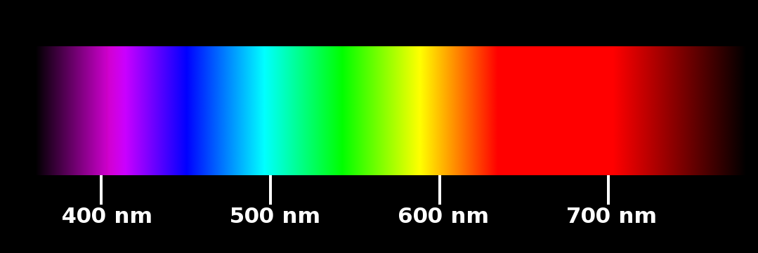

Slide 12
Lead
Others
Receive
From Others
Perceive
Yourself
Receive leadership from others as a follower
The first step of developing your leadership. Which is perceiving your characteristics, feelings, and motives
Lead others towards a common vision or goal

Slide 13
Questions?

